Slide 1
ROXI NEWHAM-BLAKE ART DIRECTOR + DESIGNER FREELANCE PORTFOLIO 2013 - 2021

Slide 2









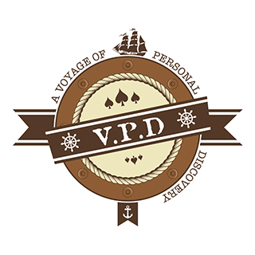





LOGO DESIGN :: SYMBOL
Client: Woolworths
Client: Volkswagen
Client: Learn To Lead
Client: GrandWest
Client: The Foschini Group
Client: The City Of Cape Town
Client: Sun International
Client: Table Bay Hotel

Slide 3














LOGO DESIGN :: TYPOGRAPHICAL
Client: The Rainbow Academy

Slide 4
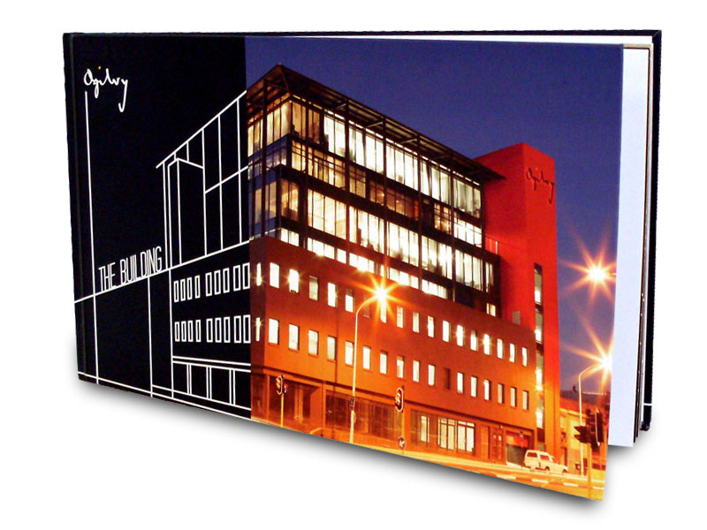
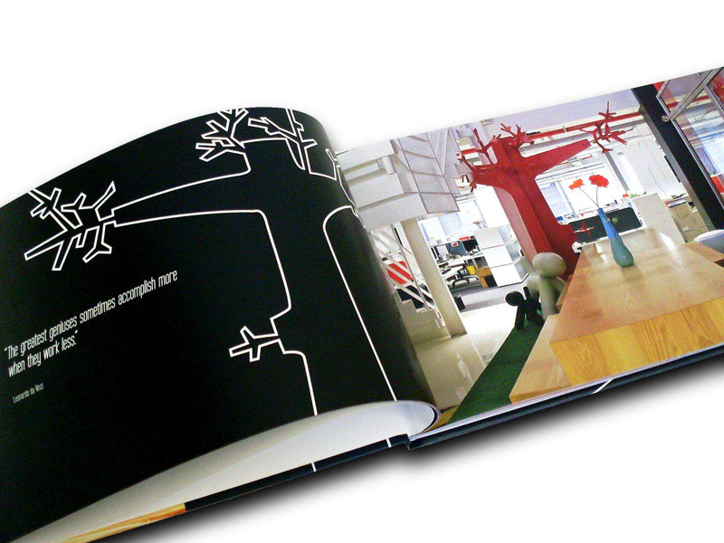
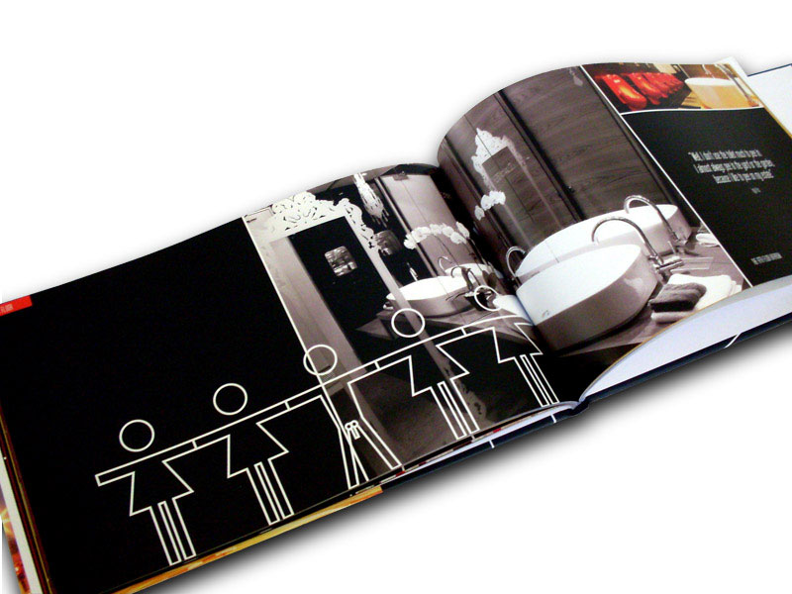
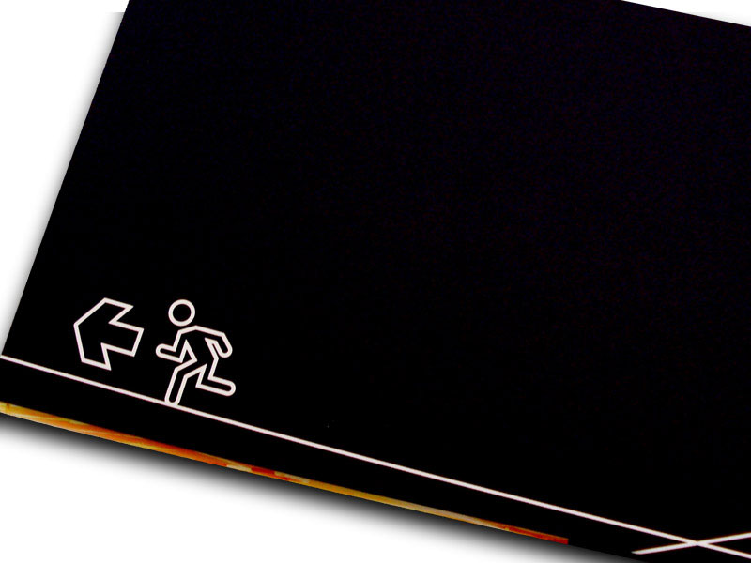

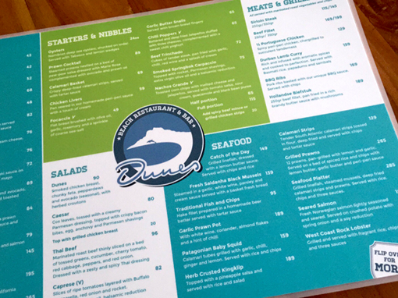
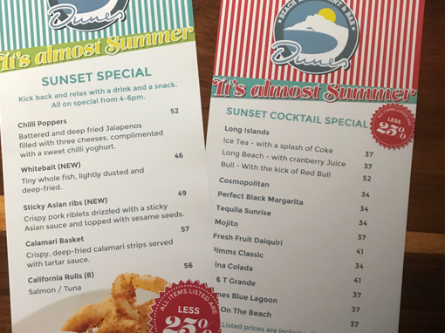
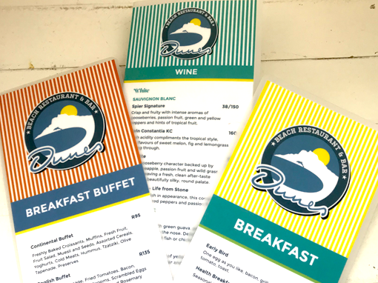
EDITORIAL & LAYOUT DESIGN
Client: Ogilvy In-house Coffee Table Book
Client: Dunes Restaurant

Slide 5

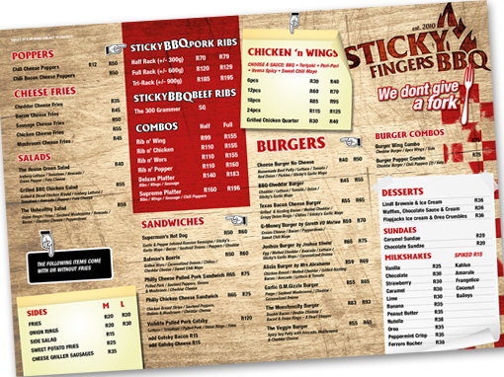
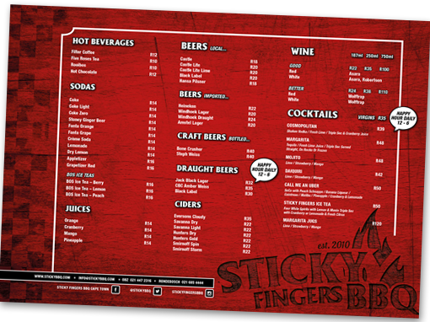
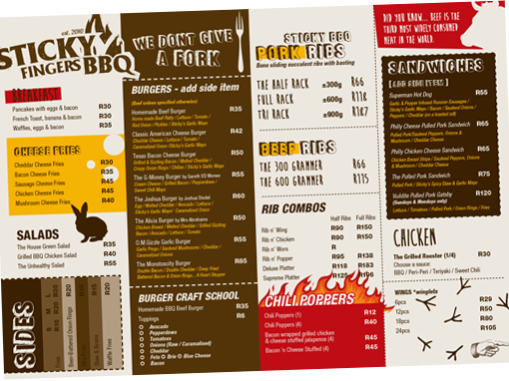



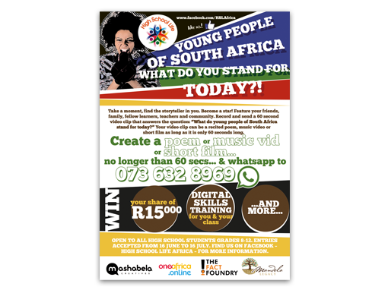
EDITORIAL & LAYOUT DESIGN
Client: The Butcher Man
Client: Sticky Fingers BBQ
Client: BioVac
Client: The Mandela Legacy

Slide 6
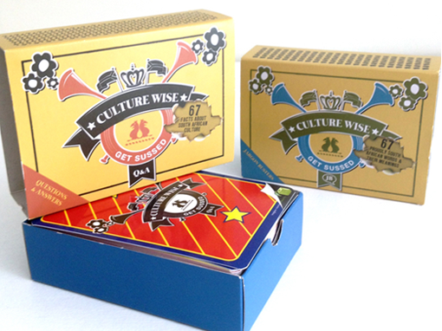
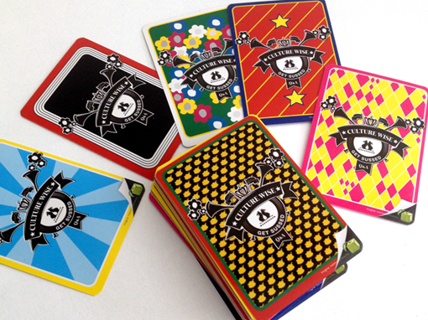

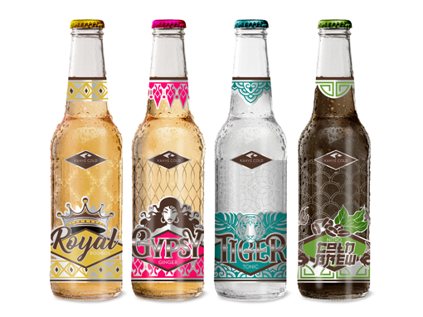




PACKAGING
Client: Learn To Lead – Training Game
Client: African Craft Gin
Client: Kahvé Road
Client: Unity Body Care (concept work)

Slide 7



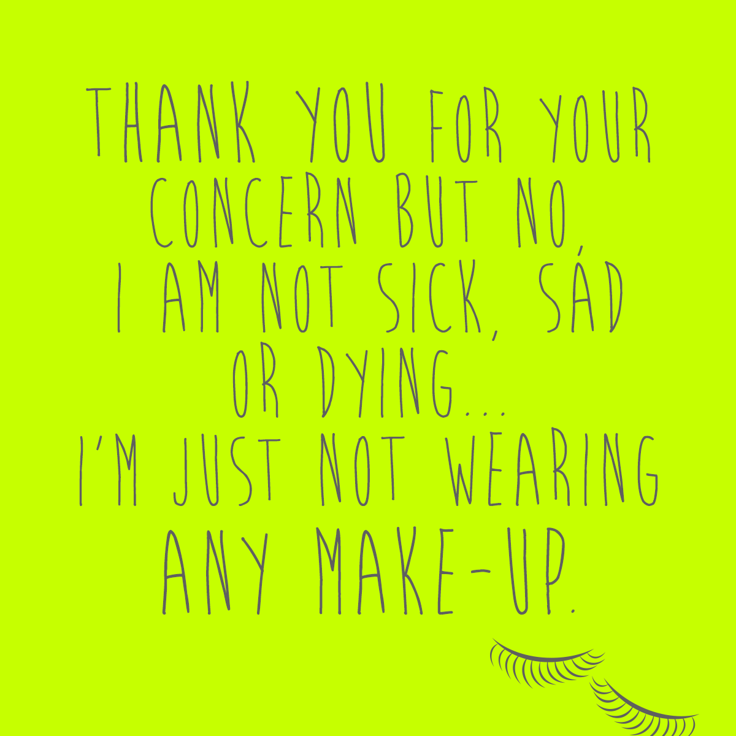





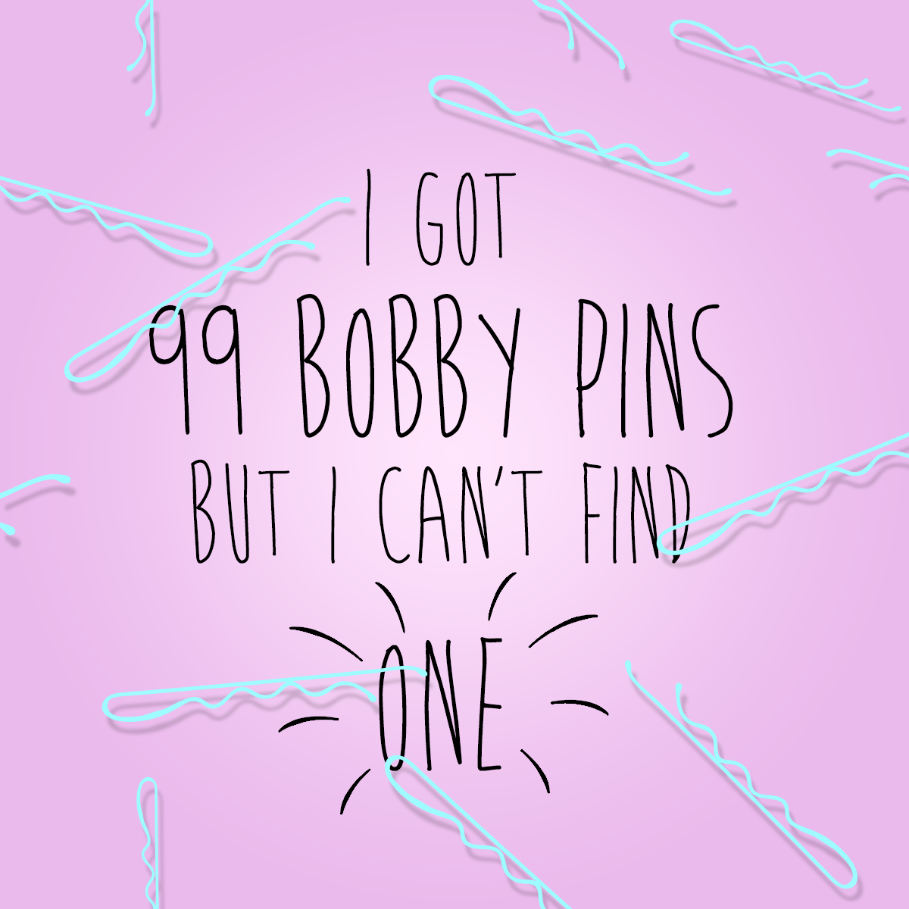







DIGITAL
Client: TPP Beauty South Africa
Client: Primedia - EWN

Slide 8
THANK YOU

